Slide 1


MATHEMATICS FOR INTELLIGENT SYSTEMS-2
21MAT117
UNDER THE GUIDANCE OF:
Dr. Sarada Jayan

Slide 2
Image Processing
BATCH E4

Slide 3
Team members:
M RAMYA SREE (BL.EN.U4AIE21072)
POLI VAMSI VARDHAN REDDY(BL.EN.U4AIE21101)
METTU SIDDHARTHA(BL.EN.U4AIE21080)

Slide 4
Contents
INTRODUCTION
DESCRIPTION
PROPERTIES
SIMULATION
OUTPUT

Slide 5

INTRODUCTION
This project has applied theory of linear algebra called “singular value decomposition (SVD)” to digital image processing.
One is digital image compression.
SVD method can transform matrix A into product USV^{T} , which allows us to refactor a digital image in three matrices.
The experiments with different singular value are performed, and the compression result was evaluated by compression ratio and quality measurement.

Slide 6
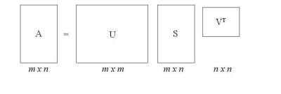
THEORY OF SINGULAR VALUE DECOMPOSITION
Process of Singular Value Decomposition
Singular Value Decomposition (SVD) is said to be a significant topic in linear algebra by many renowned mathematicians.
SVD has many practical and theoretical values; special feature of SVD is that it can be performed on any real (m, n) matrix.
Let’s say we have a matrix A with m rows and n columns, with rank r and r ≤ n ≤ m.
A = USV^{T}

Slide 7
Properties of the SVD
There are many properties and attributes of SVD, here we just present parts of the properties that we used in this project.
1. The singular value σ₁,σ₂,.....,σ_{n}. are unique, however, the matrices U and V are not unique;
2. Since A^{T}A = VS^{T} SV ^{T}, so V diagonalizes A^{T}A , it follows that the v_{j} s are the eigenvector of A^{T}A .
3. Since AA^{T} = USS^{T} U^{T} , so it follows that U diagonalizes AA^{T} and that the u_{i}’s are the eigenvectors of AA^{T} .
4. If A has rank of r then v_{j}, v_{j}, …, v_{r} form an orthonormal basis for range space of A^{T} , R(A^{T}), and u_{j}, u_{j}, …, u_{r} form an orthonormal basis for .range space A, R(A).
5. The rank of matrix A is equal to the number of its nonzero singular values .

Slide 8


SVD IN Machine Learning
Machine learning extracts information from massive sets of data.
The singular value decomposition (SVD) starts with “data” which is a matrix A, and produces “information” which is a factorization A = U ∗ S ∗ V’ that explains how the matrix transforms vectors to a new space.
In many machine learning problems, the massive sets of data can be regarded as a collection of m-vectors, which can be arranged into an m × n matrix.
SVD application examples: 1) Least-squares line, data: points in 2D; 2) Curve-fitting, data: polynomial coefficients; 3) Matrix approximation, data: entries in a matrix; 4) Image compression, data: columns of an image; 5) Facial recognition, data: pictures of a face.

Slide 9
Objective of the Project
The objective of this project is to apply linear algebra “Singular Value Decomposition (SVD) “to mid­level image processing, especially to area of image compression.
The method is factoring a matrix A into three new matrices U, S, and V, in such a way that A = USV’. Where U and V are orthogonal matrices and S is a diagonal matrix.
The experiments are conducted under different term k of singular value, and the outer product expansion of image matrix A for image compression.
MATLAB is used as a platform for programming and experiments in this project since MATLAB is high-performance in integrating computation, visualization and programming.

Slide 10


Digital Image Processing
An image can be defined as a two ­dimension on function f (x, y) (2­D image), where x and y are spatial coordinates, and the amplitude of f at any pair of (x, y) is Gray level of the image at that point
Colour images are formed by a combination of individual 2­D images. Many of the image processing techniques for monochrome images can be extend to colour image (3­D) by processing the three components image individually
Digital Image Processing (DIP) refers to processing a digital image by mean of a digital computer, and the study of algorithms for their transformation.
Digital Image processing encompasses a wide and varied field of application, such as area of image operation and compression, computer vision, and image analysis (also called image understanding).
In particular, digital image processing is practical technology in areas of : Image compression, Classification, Feature extraction, Pattern recognition, Projection, Multi­scale signal analysis
Notes:
Sfdsg

Slide 11

SVD APPLIED TO IMAGE PROCESSING
SVD Approach for Image Compression
Image compression deals with the problem of reducing the amount of data required to represent a digital image.
Compression is achieved by the removal of three basic data redundancies:
1) coding redundancy, which is present when less than optimal;
2) interpixel redundancy, which results from correlations between the pixels;
3) psychovisual redundancies, which is due to data that is ignored by the human visual.

Slide 12
SVD APPLIED TO IMAGE PROCESSING
The 5 properties of SVD tells us the rank of matrix A is equal to the number of its nonzero singular values”.
In many applications, the singular values of a matrix decrease quickly with increasing rank. This propriety allows us to reduce the noise or compress the matrix data by eliminating the small singular values or the higher ranks.
When an image is SVD transformed, it is not compressed, but the data take a form in which the first singular value has a great amount of the image information. With this, we can use only a few singular values to represent the image with little differences from the original.

Slide 13
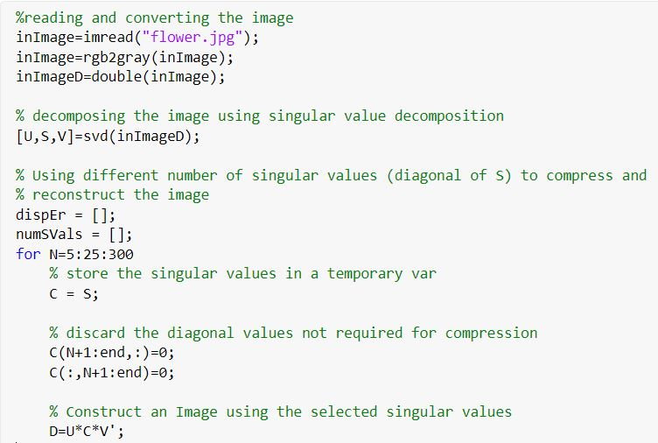
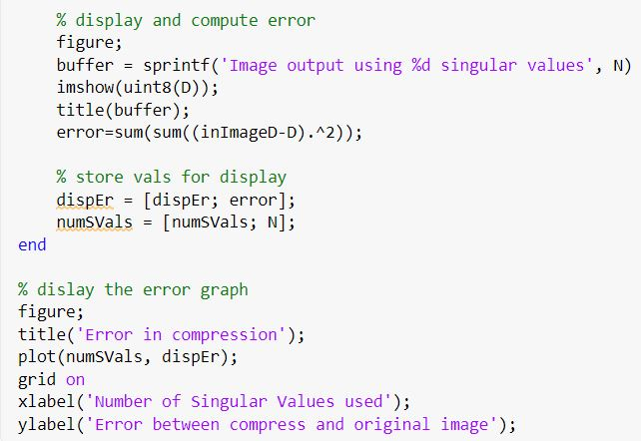
Simulation

Slide 14
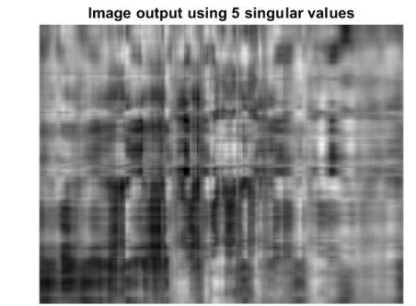
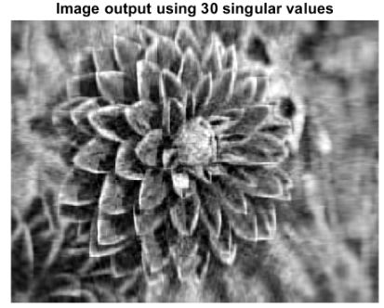
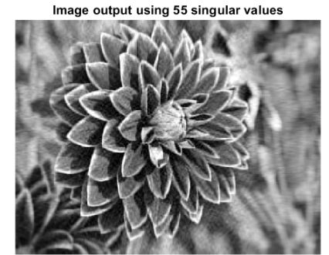
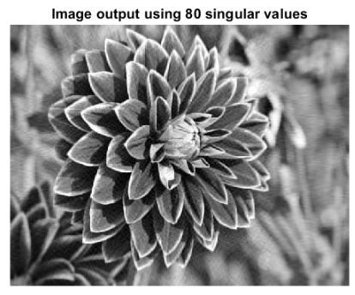
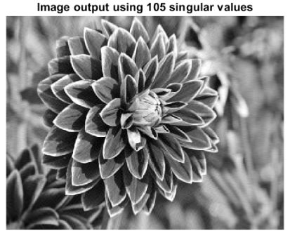
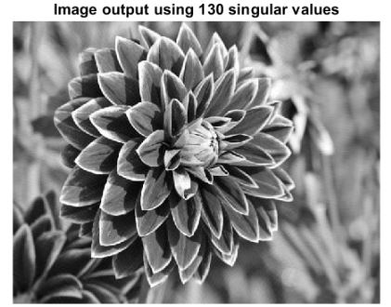
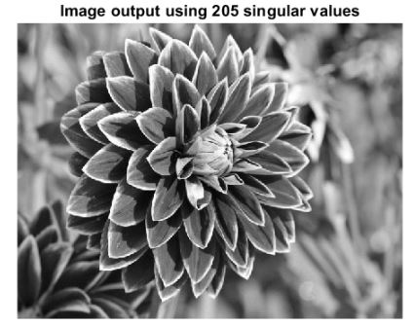
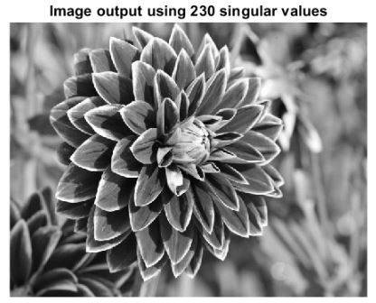
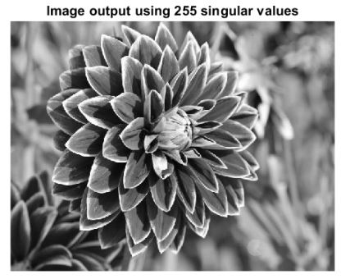
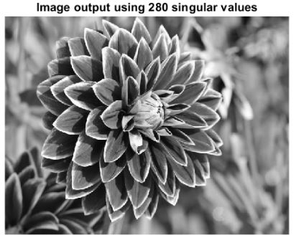

Original Image

Slide 15
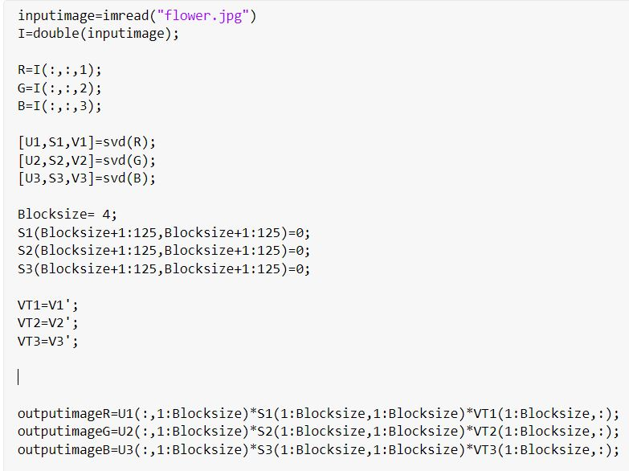
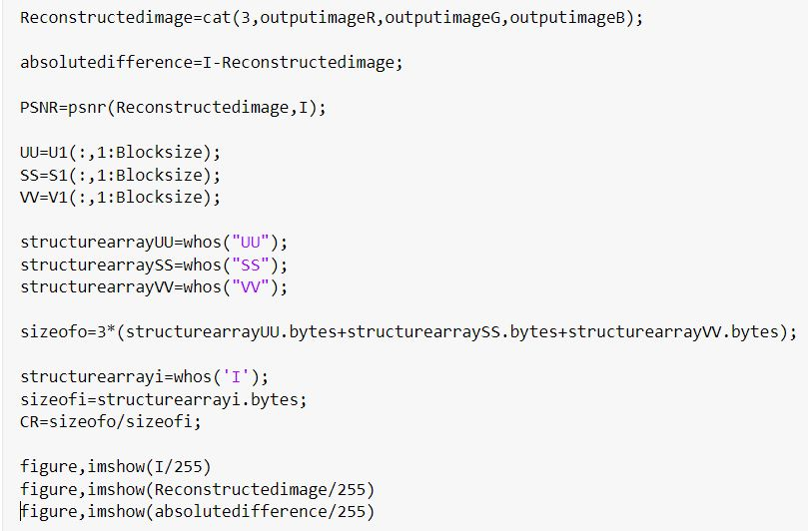
Simulation

Slide 16
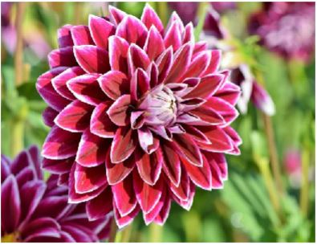
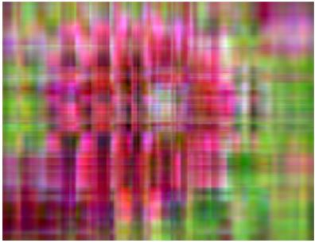
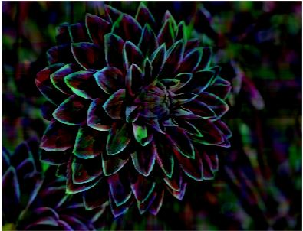
Original Image
Image Data Subspace
Noise Subspace

Slide 17
THANK YOU

